Slide 1
Vehicle Accident Trends
in London
By Tim Barry, Bailey Passmore, Brooke Rodriguez + Fiona Weston

Slide 2
Method
We took our data from Kaggle and decided that it would be interesting to investigate number of accidents and severity against other factors.
The data consisted of all UK accidents between 2005 and 2010.
Since our data set was too large for Jupyter, we limited our data by selecting the city of London only.
We then divided the data into categories of time, environmental conditions and traffic control.

Slide 3
When are accidents more likely to happen?
What time of day?
What day of the week?
What month in the year?

Slide 4
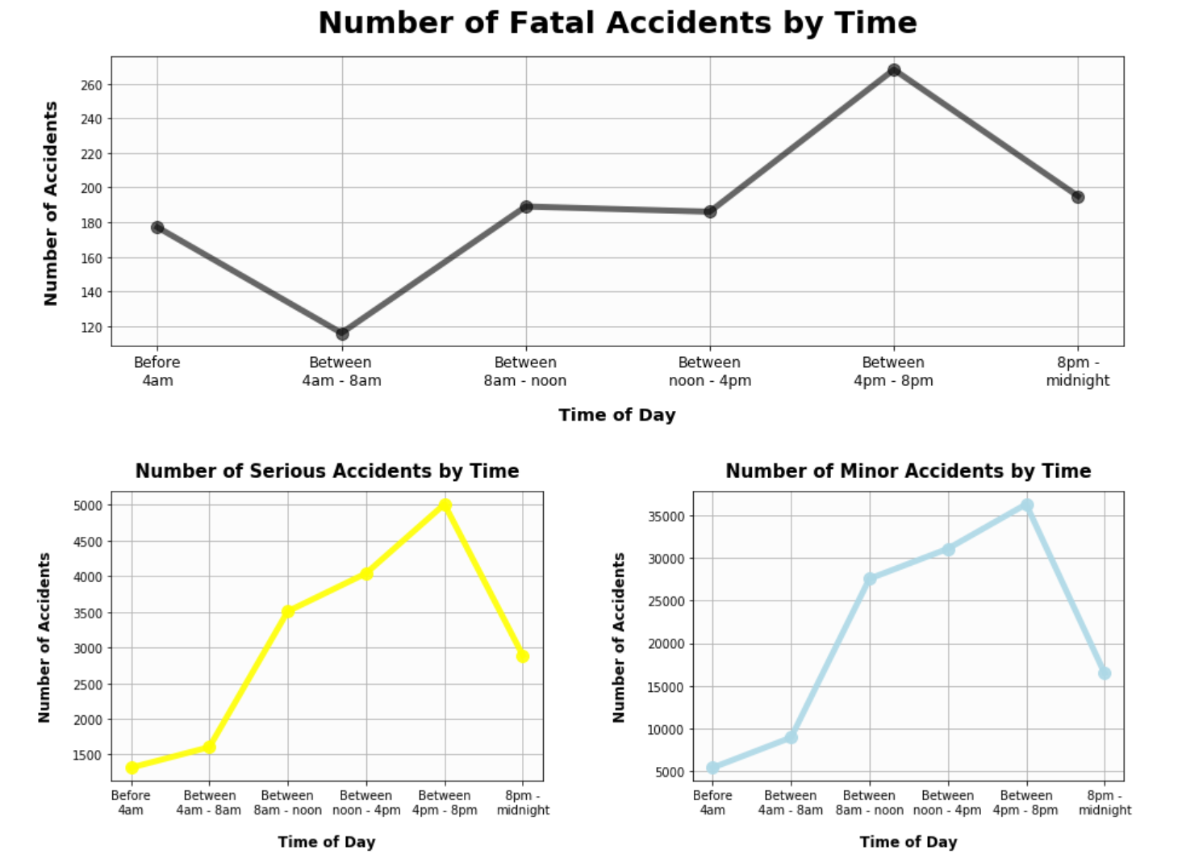
Are there more accidents during rush hour?
Peaks around 4pm - 8pm with
5,009 Serious accidents
Peaks around 4pm - 8pm with
36,311 Minor accidents
Notes:
This information is puzzling and it is difficult to draw a conclusion. What I know of traffic patterns in the U.S. lead me to believe that the accident peak between 4-8 pm is due to folks leaving work but there isn’t a peak during the morning commute.
The overwhelming majority are minor accidents.

Slide 5
Are there more accidents during rush hour?
Peaks between 4pm - 8pm with
268 Fatal accidents
Notes:
Fatal accidents are by far the lowest type of accident also peaking between 4-8pm.

Slide 6
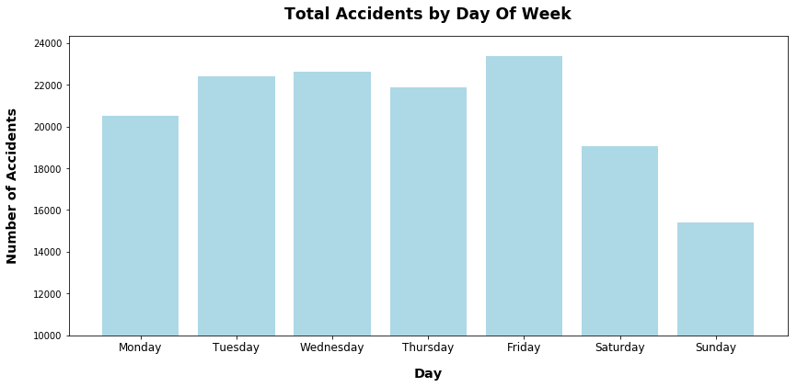
Are accidents more likely on a weekday?
Notes:
Most accidents take place during weekdays, peaking on Friday. This could be explained by more

Slide 7
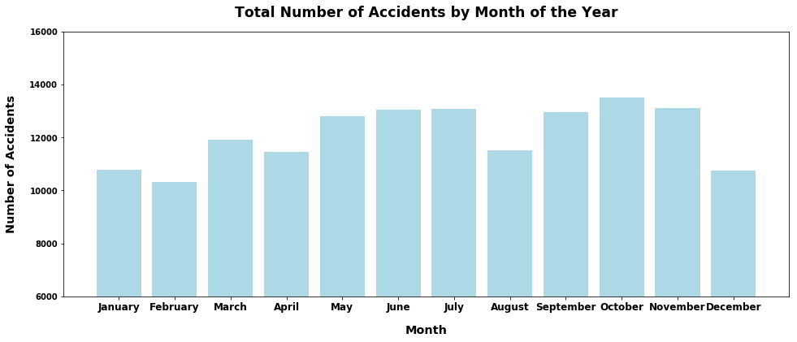
Are there a greater number of accidents in specific seasons?

Slide 8
All accident types increase in number between 4 and 8 pm.
There are are no significant differences among each day of the week but weekdays tend to be higher generally, peaking on Friday.
As with day of the week, there aren’t any significant differences by month however, Autumn appears to have more overall with February having the lowest accident rate.

Slide 9
What about environmental conditions
Does light play a role?
Is it really worse when raining?
What about what’s on the road?

Slide 10
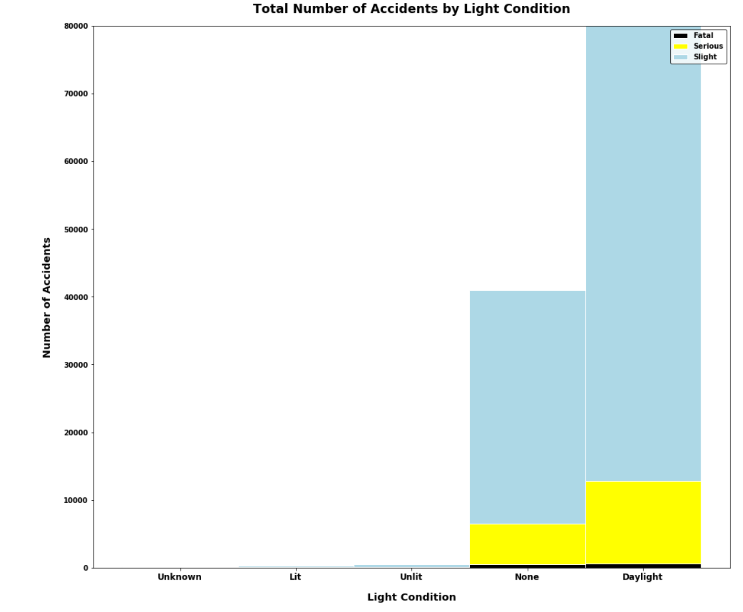
Are there more accidents when it is dark?
Notes:
No, most accidents off all types occur during the day double the amount of accidents when there is no light at all which follows in number.

Slide 11
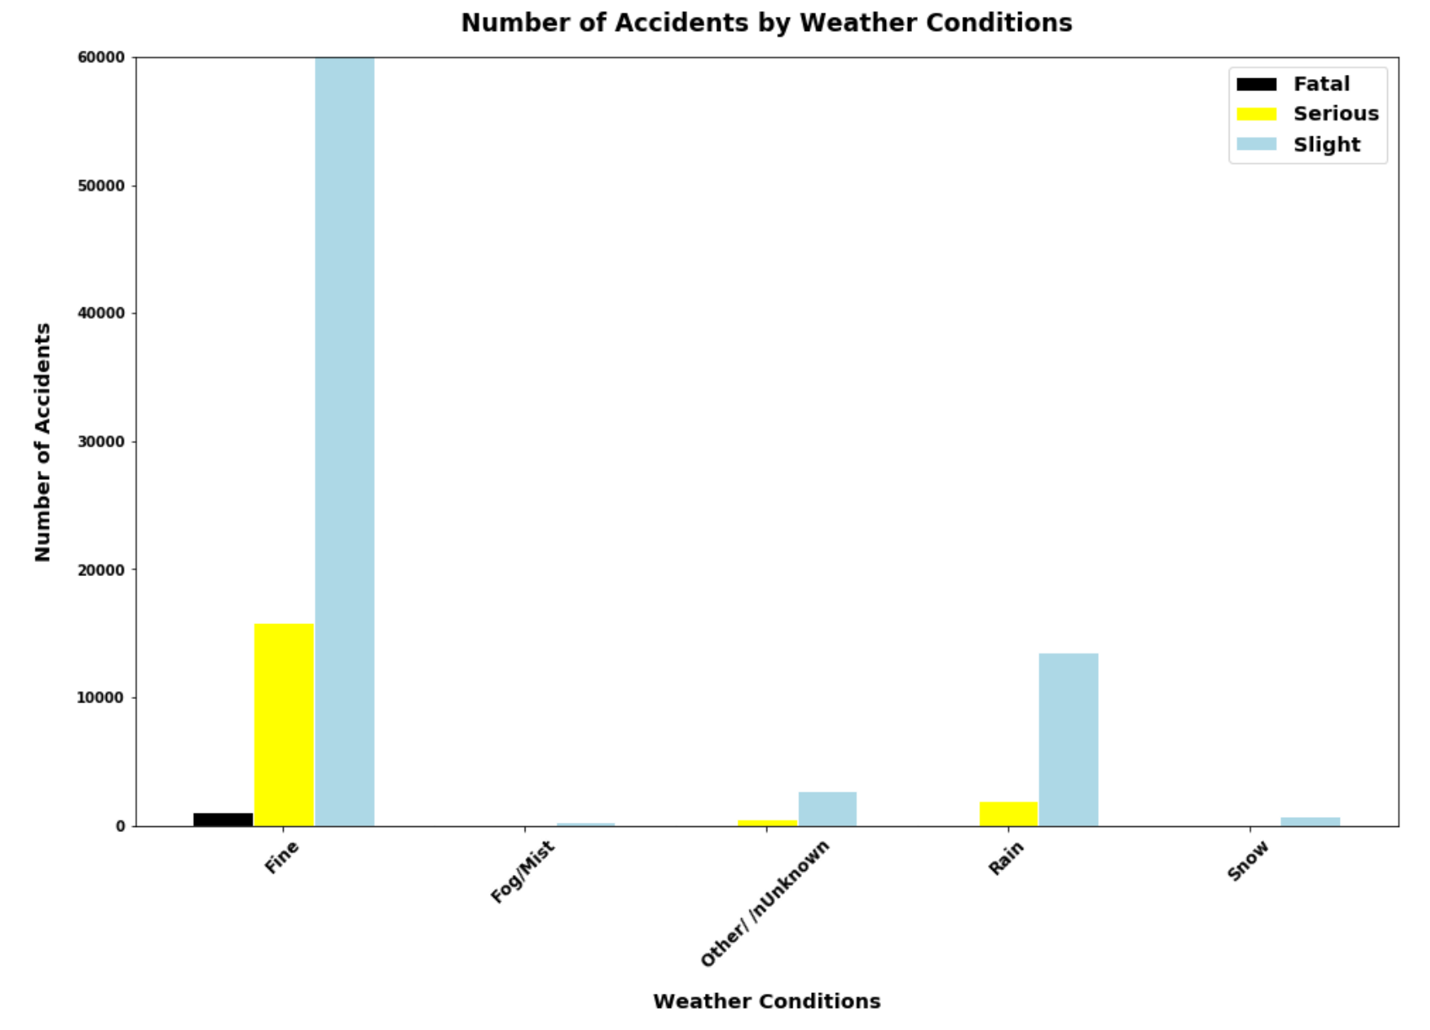
Does snow or rain have an impact?
Notes:
Surprisingly most accidents of all types occur when weather conditions are fine. Perhaps drivers are less cautious. This could also be due there being more days of year with mild weather conditions.

Slide 12
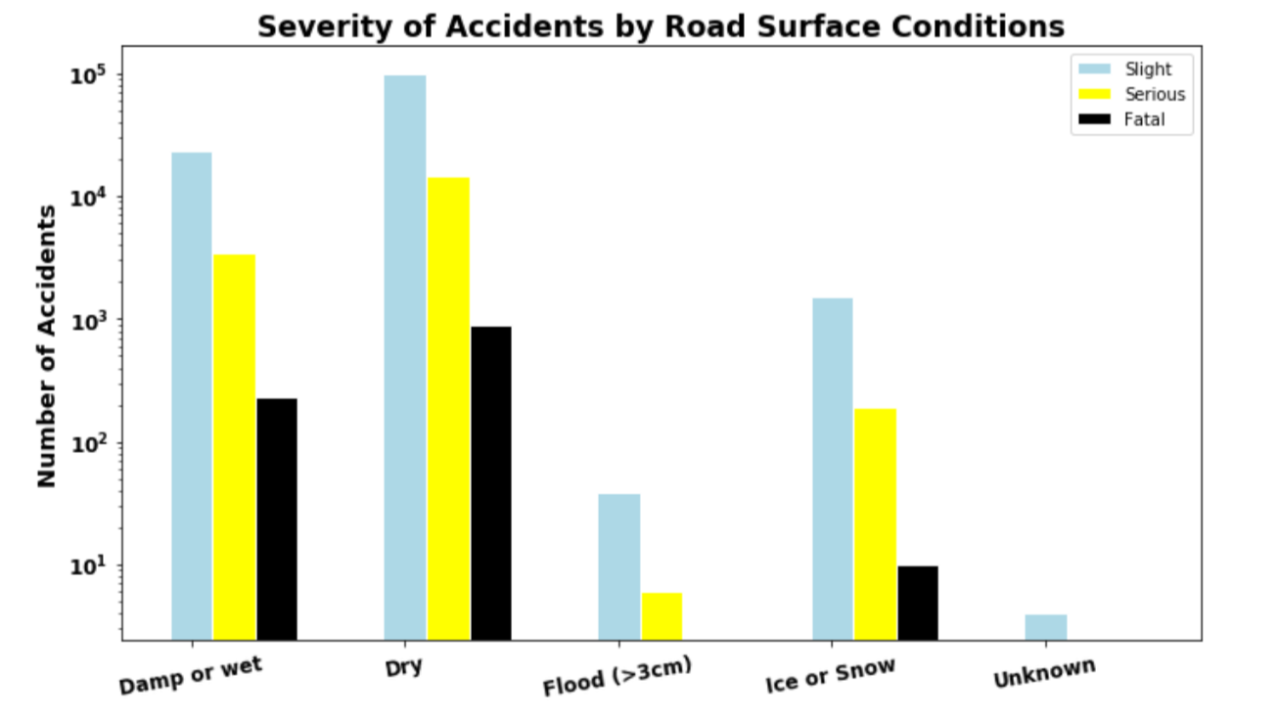
How about when the snow and rain is on the ground?
Notes:
Observations:
Data here is giving very unintuitive results:
A)Driving in dry weather is far more dangerous than “wet or damp”.
B)Frost and ice is pretty common in winter but only accounts for 10 fatalities as opposed to 892 fatalities for dry conditions.
C)Snow is not that common in London so data there is unsurprising.

Slide 13
How does traffic control impact outcome?
Do stop signs help?
Does faster mean fatal?

Slide 14
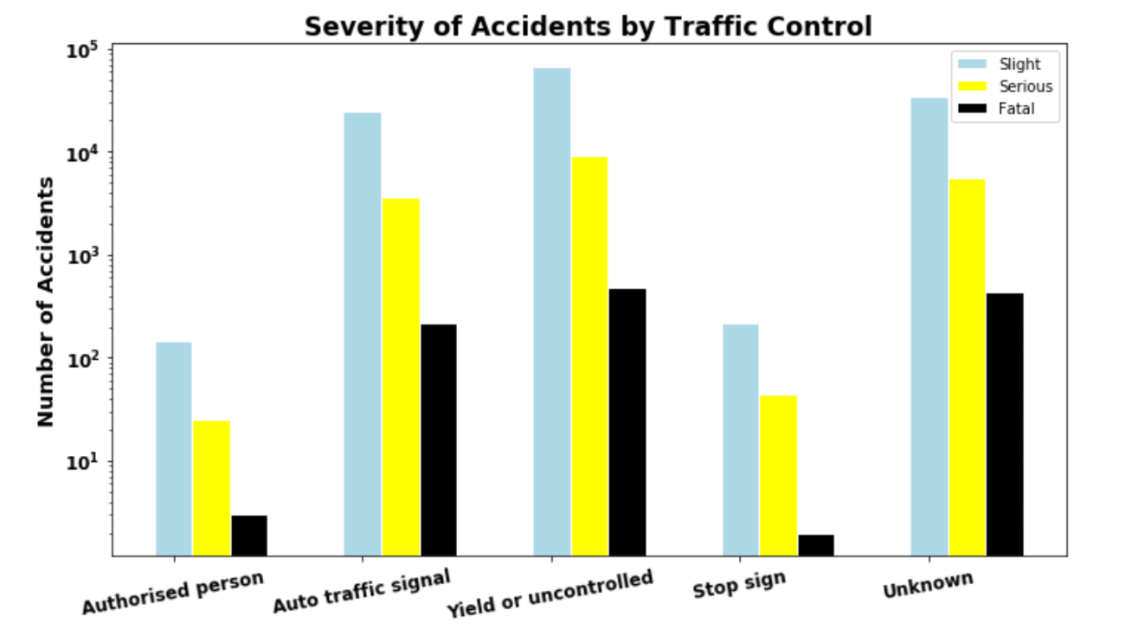
Does traffic control lower the number of accidents?
Notes:
Observations:
A)Give Way/Uncontrolled is the most dangerous Traffic control method with the highest number of all levels of accidents.
B)Traffic signals are surprisingly higher (by 2 orders of magnitude )than Stop Signs.
C)Stop signs and a traffic control person are both highly effective at preventing fatal accidents (<10) each over 5 years of data.

Slide 15
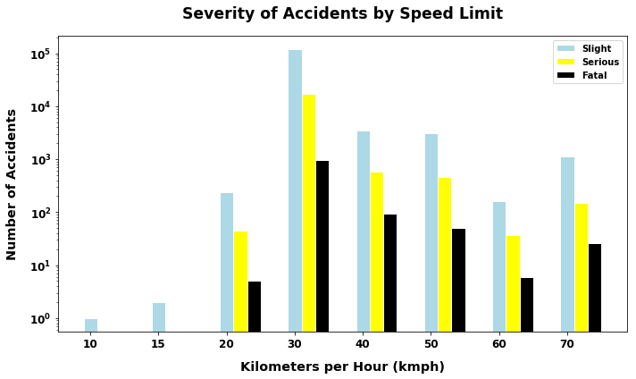
Are there more fatal accidents at higher speeds?
Miles per Hour (mph)
Notes:
Observations:
A)Speed Limit of 30mph accounts for the greatest chuck of accidents by far.
A possible reason may be people driving at speeds greater than posted speed limit.
B)10 and 15 mph limits are normally in residential areas and it would seem that people take that more seriously than the 30mph limit.

Slide 16
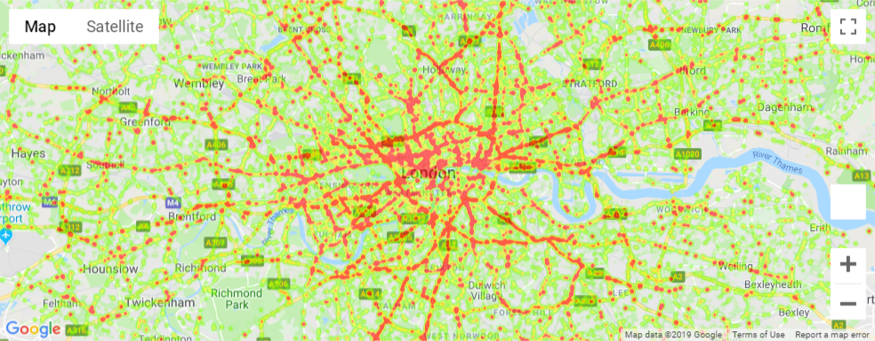
Are there more accidents in urban vs rural areas?
Notes:
We wanted to use severity of accident as the weight for our heat map

Slide 17
Post Mortem/Challenges
Large data set of over 1.6 million accidents ~ CSV too large for Jupyter Notebook
Large range of data ~ scaling y values vs. combining categories
Formatting and presenting clean visuals ~ what graphs capture the data best
Weighting the heatmap by severity of accident ~ converting severity to integers
Utilizing Date and Time values presented as Strings and not DateTime objects

Slide 18
Thank you!

